Slide 1

Noida Institute of Engineering and Technology, Greater Noida
Web Mining
Unit: 2
Data Analytics ACSAI0622N
Ms. Aarushi Thusu
Assistant Professor
CSE-AIML
B.Tech 6th Semester

Slide 2
Faculty Introduction
Name | Aarushi Thusu
Qualification | M. Tech. (Artificial Intelligence)
Designation | Assistant Professor
Department | AIML
NIET Experience | 2.5 Years
Subject Taught | Data Analytics, Introduction to Artificial Intelligence, Social Media Analytics, Cyber Security

Slide 3
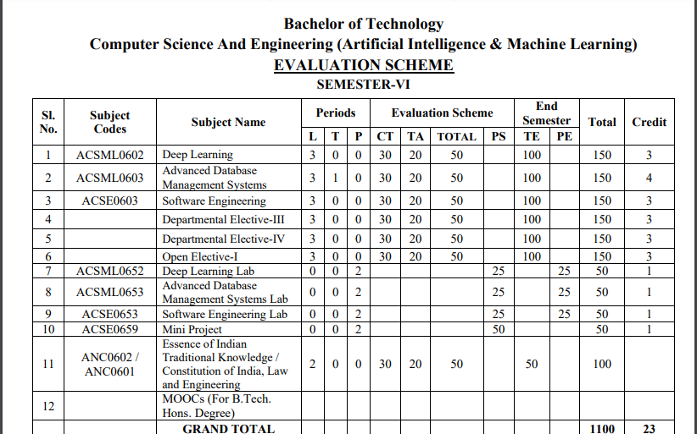
Evaluation Scheme

Slide 4
Syllabus
UNIT-I:SENTIMENT MINING
Overview: Text and Sentiment Mining, Semantic Analysis Applications, Sentiment Analysis Process, Speech Analytics, Text Representation- tokenization, stemming, stop words, TF-IDF, Feature Vector Representation, NER, N-gram modelling, Text Clustering, Text Classification, Topic Modelling-LDA, HDP. Sentiment Classification, feature based opinion mining, comparative sentence, and relational mining, Opinion summarization, Opinion spam detection.

Slide 5
Syllabus
UNIT-II:WEB MINING
Web Mining Overview, Web Structure Mining, Search Engine, Web Analytics, Machine Learning for extracting knowledge from the web, Inverted indices and Boolean queries. PLSI, Query optimization, SEO, page ranking, Social Graphs (Interaction, Latent and Following Graphs), Ethics of Scraping, Static data extraction and Web Scraping using Python

Slide 6
Syllabus
UNIT-III: MINING SOCIAL MEDIA
Introduction to Social Media Mining, Challenges in Social Media Mining, Process of Social media Mining, Essentials of Social graphs and its types, Social Networks Measures, Network Models, Information Diffusion in social media, Behavioural Analytics, Influence and Homophily, Recommendation in social media.

Slide 7
Syllabus
UNIT-IV: TEXT SUMMARIZATION
Introduction to Text Summarization, Text extraction, classification and clustering, Anomaly and Trend Detection, Text Processing, N-gram Frequency Count and Phrase Mining, Page Rank and Text Rank Algorithm, LDA Topic Modelling, Machine-Learned Classification and Semantic Topic Tagging, Python libraries for Text Summarization(NumPy, Pandas, NLTK, Matplotlib)

Slide 8
Syllabus
UNIT-V: RECENT TRENDS
Trend Analysis, Types of trend analysis, Recent Trends in Text, Data Localization, Role of Web Mining in E-Commerce, Social Media Analytics, Social Media Analytics tools.
Case Studies: Facebook Insights Using Python, Sentiment and Text Mining of Twitter data and Google analytics.

Slide 9
Branch Wise Applications
1.Security
2. Digital Advertising
3. E-Commerce
4. Publishing
5. Massively Multiplayer Online Games
6. Backend Services and Messaging
7. Project Management & Collaboration
8. Real time Monitoring Services
9.Live Charting and Graphing
10. Group and Private Chat

Slide 10
Course Objective
To understand text mining and social media data analytic activities and apply the complexities of processing text and network data from different data sources.

Slide 11
Course Outcomes
At the end of course, the student will be able to:
Design new solutions to opinion extraction, sentiment classification and data summarization problems.
Apply a wide range of classification ,clustering ,estimation and prediction algorithms on web data.
Perform social network analysis to identify important social actors, subgroups and network properties in social media sites.
Interpret the terminologies ,metaphors of text summarization.
Apply state of the art mining tools and libraries on realistic data sets as a basic for business decisions and applications.

Slide 12
Program Outcomes
Engineering Graduates will be able to:
PO1 : Engineering Knowledge
PO2 : Problem Analysis
PO3 : Design/Development of solutions
PO4 : Conduct Investigations of complex problems
PO5 : Modern tool usage
PO6 : The engineer and society

Slide 13
Program Outcomes
Engineering Graduates will be able to:
PO7 : Environment and sustainability
PO8 : Ethics
PO9 : Individual and teamwork
PO10 : Communication
PO11 : Project management and finance
PO12 : Life-long learning

Slide 14

CO-POs Mapping
CO.K | PO1 | PO2 | PO3 | PO4 | PO5 | PO6 | PO7 | PO8 | PO9 | PO10 | PO11 | PO12
CO1 | 2 | 2 | 2 | 3 | 3 | - | - | - | - | - | - | -
CO2 | 3 | 2 | 3 | 2 | 3 | - | - | - | - | - | - | -
CO3 | 3 | 2 | 3 | 2 | 3 | - | - | - | - | - | - | -
CO4 | 3 | 2 | 3 | 2 | 3 | - | - | - | - | - | - | -
CO5 | 3 | 2 | 3 | 3 | 3 | - | - | - | - | - | - | -
AVG | 2.8 | 2.0 | 2.8 | 2.4 | 3.0 | - | - | - | - | - | - | -

Slide 15
Program Specific Outcomes
S. No. | Program Specific Outcomes (PSO) | PSO Description
1 | PSO1 | Design innovative intelligent systems for the welfare of the people using machine learning and its applications.
2 | PSO2 | Demonstrate ethical, professional and team - oriented skills while providing innovative solutions in Artificial Intelligence and Machine Learning for life-long learning.

Slide 16
CO-PSOs Mapping
CO.K | PSO1 | PSO2
CO1 | 3 | -
CO2 | 3 | 2
CO3 | 3 | 3
CO4 | 3 | 3
CO5 | 3 | 3

Slide 17
Program Educational Objectives
Program Educational Objectives (PEOs) | PEOs Description
PEOs | Pursue higher education and professional career to excel in the field of Artificial Intelligence and Machine Learning.
PEOs | Lead by example in innovative research and entrepreneurial zeal for 21st century skills.
PEOs | Proactively provide innovations solutions for societal problems to promote life-long learning.
Aarushi Thusu ACSAI0622 Social Media Analytics Unit 5

Slide 18
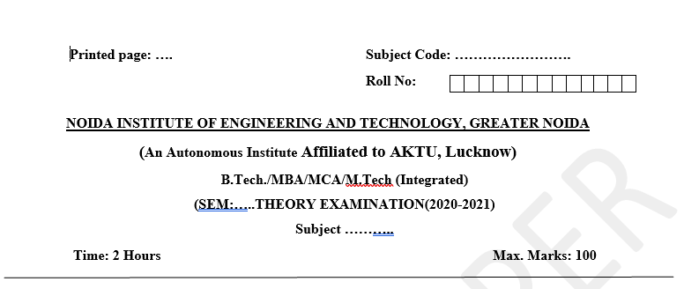
Pattern of External Exam Question Paper

Slide 19
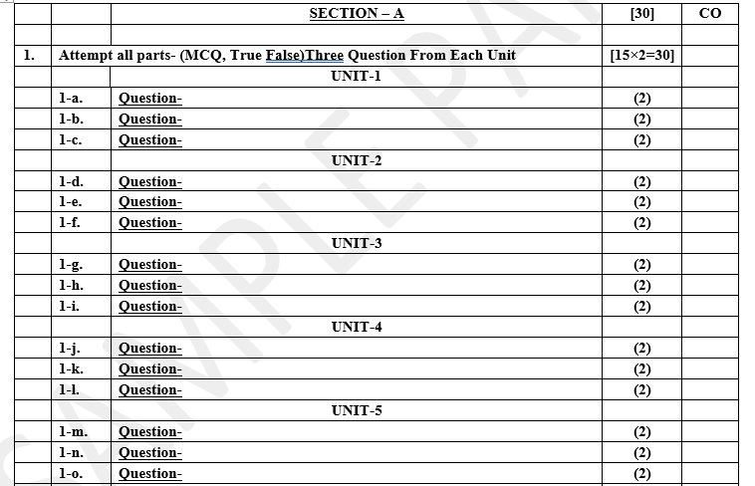
Pattern of External Exam Question Paper

Slide 20
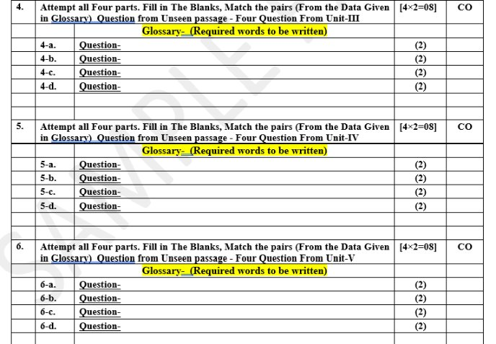
Pattern of External Exam Question Paper

Slide 21
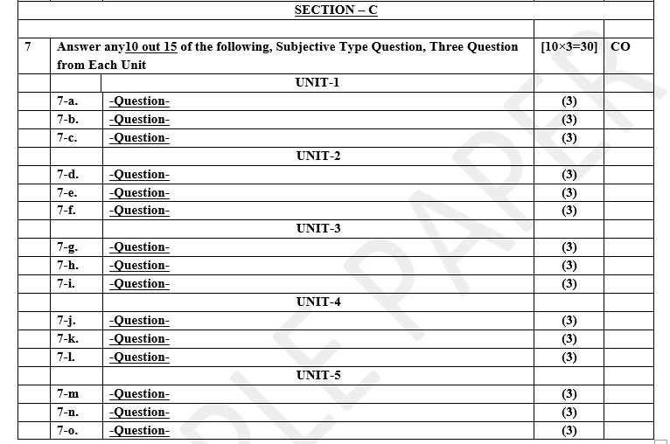
Pattern of External Exam Question Paper

Slide 22
Brief Introduction about the Subject and Videos
YouTube /other Video Links
https://www.youtube.com/watch?v=Uqs0GewlMkQ
https://www.youtube.com/watch?v=tUNwSH7671Y&t=2s
https://slideplayer.com/slide/14222744/
https://www.youtube.com/watch?v=KjWu1
dZn00https://www.youtube.com/watch?v=ntOaoW0T604

Slide 23
Unit Content
Web Search
Data Mining
and Machine Learning for extracting knowledge from the web,
Inverted indices and Boolean queries.
PLSI,
Query optimization,
page ranking,
Essentials of Social graphs,
Social Networks,
Models,
Information Diffusion in social media.

Slide 24
Unit Objective
Web mining can help you to discover your customers' key initiatives and their financial situation.
Student will able to understand mining tools that helped them to identify various criminal activities..
Student will able to define web searches.
Describe Data Mining and Social Networks
Define Information Diffusion in social media.

Slide 25
Web Search
A search engine is a software system designed to carry out web searches. The most productive way to conduct a search on the internet is through a search engine. A web search engine is a software system designed to search for information on the World Wide Web. The search results are generally presented in a line of results often referred to as search engine results pages (SEROs). The information may be a mix of web pages, images, and other types of files. Some search engines also mine data available in databases or open directories.
There are a number of various search engines available and some of them may seem familiar to you. The top web search engines are Google, Bing, Yahoo, Ask.com, and AOL.com. For the purpose of this course, we will be searching using the Google Chrome web browser, and search first with the Google search engine and then Microsoft’s Bing search engine.

Slide 26
Data Mining
Data mining is the process of extracting knowledge or insights from large amounts of data using various statistical and computational techniques. The data can be structured, semi-structured or unstructured, and can be stored in various forms such as databases, data warehouses, and data lakes.
The primary goal of data mining is to discover hidden patterns and relationships in the data that can be used to make informed decisions or predictions. This involves exploring the data using various techniques such as clustering, classification, regression analysis, association rule mining, and anomaly detection.

Slide 27
Data Mining
Advantages of Data Mining:
Assists in preventing future adversaries by accurately predicting future trends.
Contributes to the making of important decisions.
Compresses data into valuable information.
Provides new trends and unexpected patterns.
Helps to analyze huge data sets.
Aids companies to find, attract and retain customers.

Slide 28
Data Mining
Disadvantages of Data Mining:
Excessive work intensity requires high-performance teams and staff training.
The requirement of large investments can also be considered a problem as sometimes data collection consumes many resources that suppose a high cost.
Lack of security could also put the data at huge risk, as the data may contain private customer details.
Inaccurate data may lead to the wrong output.
Huge databases are quite difficult to manage.

Slide 29
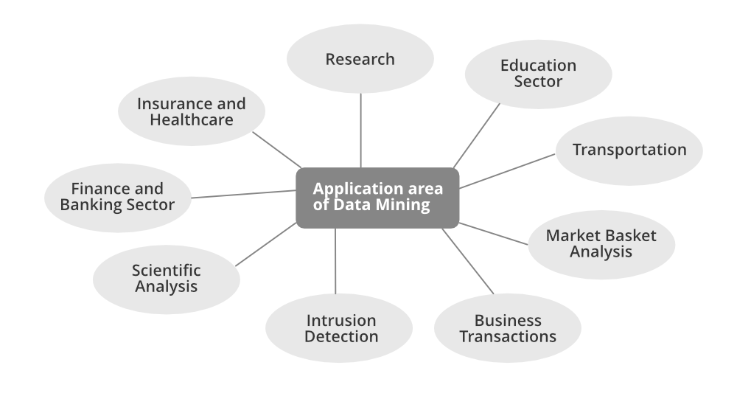
Data Mining

Slide 30
Machine learning, particularly techniques like natural language processing (NLP) and deep learning, can be effectively used to extract knowledge from the web by automatically analyzing large amounts of text data from websites, identifying patterns, entities, relationships, and key information to generate structured insights without manual intervention, allowing for efficient knowledge discovery and analysis across diverse web content.
Machine Learning for extracting knowledge from the web

Slide 31
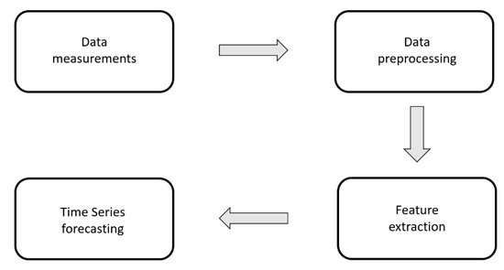
Machine Learning for extracting knowledge from the web

Slide 32
An Inverted Index is a data structure used in information retrieval systems to efficiently retrieve documents or web pages containing a specific term or set of terms. In an inverted index, the index is organized by terms (words), and each term points to a list of documents or web pages that contain that term.
Inverted indexes are widely used in search engines, database systems, and other applications where efficient text search is required.
Inverted Index

Slide 33
Steps to Build an Inverted Index Fetch the Document: Removing of Stop Words: Stop words are the most occurring and useless words in documents like “I”, “the”, “we”, “is”, and “an”. Stemming of Root Word: Whenever I want to search for “cat”, I want to see a document that has information about it. But the word present in the document is called “cats” or “catty” instead of “cat”. To relate both words, I’ll chop some part of every word I read so that I could get the “root word”. There are standard tools for performing this like “Porter’s Stemmer”. Record Document IDs: If the word is already present add a reference of the document to index else creates a new entry. Add additional information like the frequency of the word, location of the word, etc.
Inverted Index

Slide 34
Boolean queries are search queries that use Boolean operators to narrow down or expand search results. Boolean operators are symbols or words that help search engines combine, exclude, or specify certain terms or phrases. Boolean operators AND: Combines two or more search criteria into one string OR: Separates keywords in a search query, and can be used to create multiple searches within an alert NOT: Excludes specific words from the search Proximity: Filters results based on the proximity of one keyword to another
Boolean Queries

Slide 35
Using Boolean operators Boolean operators can help find search results faster and with more precision Parentheses and quotation marks can also be used in Boolean search strings. Examples of Boolean queries AND: Combine two or more search criteria into one string OR: Separate keywords in a search query, and can be used to create multiple searches within an alert NOT: Exclude specific words from the search.
Boolean Queries

Slide 36
In web mining, "PLSI" stands for "Probabilistic Latent Semantic Indexing," which is a statistical technique used to discover hidden topics or themes within large collections of web documents by analyzing the co-occurrence of words, essentially allowing you to group related web pages together based on their underlying semantic meaning, even if they use different wording; it's a powerful tool for tasks like document clustering, topic modeling, and information retrieval on the web.
PLSI

Slide 37
Applications of PLSI in web mining: Web content analysis: Identifying major themes and topics discussed across a large collection of web pages. Search engine ranking: Improving search relevance by considering the topic distribution of web pages when ranking results
PLSI

Slide 38
Customer behavior analysis: Understanding user interests based on the web pages they visit by identifying latent topics associated with their browsing patterns. Personalized recommendations: Providing users with relevant content recommendations based on their inferred topic interests
PLSI

Slide 39
Query Optimization is a crucial aspect of database management systems (DBMS) that seeks to determine the most efficient way to execute a given query by considering a variety of query execution strategies. The goal is to minimize the system resources required to fulfill the query and increase the speed of returned results. Query optimization is a process of defining the most efficient and optimal way and techniques that can be used to improve query performance based on rational use of system resources and performance metrics. The purpose of query tuning is to find a way to decrease the response time of the query, prevent the excessive consumption of resources, and identify poor query performance.
Query Optimization

Slide 40
The page rank algorithm is applicable to web pages. The page rank algorithm is used by Google Search to rank many websites in their search engine results. The page rank algorithm was named after Larry Page, one of the founders of Google. We can say that the page rank algorithm is a way of measuring the importance of website pages. A web page basically is a directed graph which is having two components namely Nodes and Connections. The pages are nodes and hyperlinks are connections.
Page Ranking

Slide 41
Advantages of Page Ranking: Identifies important content: By analyzing link structures, PageRank effectively identifies pages considered important within a network, like the most relevant web pages for a given search query. Simple to implement: The core concept of PageRank is relatively straightforward, making it easy to apply in various data mining scenarios. Scalability: PageRank can efficiently handle large datasets with numerous connections, like the entire web, due to its iterative calculation process.
Page Ranking

Slide 42
Disadvantages of Page Ranking: Link manipulation vulnerability: Malicious actors can artificially inflate a page's rank by creating a large number of low-quality backlinks, impacting search results. Bias towards older pages: New, high-quality pages may initially have a lower PageRank simply because they haven't accumulated many links yet. Limited content analysis: PageRank only considers link structure, not the actual content on a page, potentially overlooking valuable information not well-linked to.
Page Ranking

Slide 43
1. It is a program in search tool, that helps the user in searching the information that is interrelated to the specific topic. A. Search engine B. Search directory C. Search box D. none of these 2. Which one of the following refers to querying the unstructured textual data? A. Information access B. Information update C. Information retrieval D. None of these
Daily Quiz

Slide 44
3. Which of the following is an essential process in which the intelligent methods are applied to extract data patterns? A. Warehousing B. Data Mining C. Text Mining D. Data Selection 4. For what purpose, the analysis tools pre-compute the summaries of the huge amount of data? A. In order to maintain consistency B. For authentication C. For data access D. To obtain the queries response
Daily Quiz

Slide 45
5. What are the functions of Data Mining? A. Association and correctional analysis classification B. Prediction and characterization C. Cluster analysis and Evolution analysis D. All of the above 6. A data structure that maps terms back to the parts of a document in which they appear is called a) Lexicon b) Dictionary c) Inverted index d) All of the above
Daily Quiz

Slide 46
A social graph is a model that shows the connections between people, groups, and organizations in a social network. It's a way to visualize how these entities relate to each other. How does a social graph work? Nodes: Represent people, places, or other entities in the network Edges: Lines that show the relationships between nodes, such as "friend" or "follow" Data: Content shared between nodes, such as a tweet or a "like" Jumping functions: Ways to share data between subgroups of users, such as retweeting or liking
Social Graphs

Slide 47
What can a social graph show? Relationships: Who knows who, and how they are connected Relationship clusters: Groups of related entities Content: What content is shared between entities, and how that content influences users' experiences. How can a social graph be used? Personalization Social graphs can be used to personalize user experiences, such as by recommending content based on a user's connections Business Social graphs can be used to map out commercial relationships, such as between companies and their customers.
Social Graphs

Slide 48
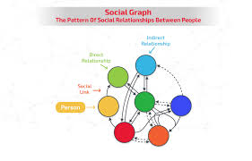
Social Graphs

Slide 49
A social network is a website or app that allows people to connect with each other and build relationships. People use social networks to share information, express opinions, and explore common interests. Why people use social networks? Personal reasons: To stay in touch with friends and family, share important milestones, or connect with others who share similar interests. Professional reasons: To market their business, advance their business goals, or search for jobs
Social Graphs

Slide 50
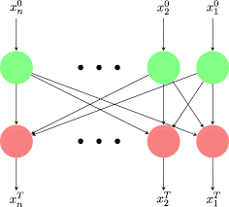
Information diffusion in social media" refers to the process by which information spreads through a social network, like Facebook or Twitter, where users share content with their connections, causing it to propagate across the platform, similar to how information spreads through word-of-mouth communication in real life; this process is influenced by the network structure and individual user behavior, with some users acting as key influencers who drive the spread of information more effectively than others.
Social Graphs

Slide 51
Weekly/Monthly Assignment
What is Web Mining?
What are the three main categories of Web Mining?
How does Web Mining differ from Data Mining?
What are the key challenges in Web Mining?
What are some applications of Web Mining?
What is Web Structure Mining?
How does Web Structure Mining help in analyzing web connectivity?
What is the role of hyperlink analysis in Web Structure Mining?
What is a Directed Graph in Web Structure Mining?
How does Web Structure Mining differ from Web Content Mining?

Slide 52
Weekly/Monthly Assignment
1. What are the main components of a Search Engine?
2. What is the purpose of a web crawler in search engines?
3. How do search engines index web pages?
4. What is the difference between organic and paid search results?
5. What are some challenges faced by search engines?
6. What is Web Analytics?
7. What are the key metrics measured in Web Analytics?
8. How does Web Analytics help in improving user experience?

Slide 53
Weekly/Monthly Assignment
How is Machine Learning used in Web Mining?
What is the role of Natural Language Processing (NLP) in Web Mining?
What are some common ML techniques used for Web Knowledge Extraction?
What is the importance of Feature Engineering in Web Mining?
How can supervised and unsupervised learning be applied to Web Mining?
What is an Inverted Index in the context of search engines?
How does an Inverted Index improve search efficiency?
What is a Boolean Query in Information Retrieval?

Slide 54
Glossary Questions
The three main categories of Web Mining are ______, ______, and ______.
In Web Structure Mining, a ______ is used to represent the relationships between web pages through hyperlinks.
A ______ is a program used by search engines to systematically browse and index web pages.
An ______ is a data structure used by search engines to map terms to their locations in a database or document collection.
______ refers to the process of improving a website's visibility on search engine results pages through unpaid methods.
The ______ file on a website specifies which parts of the site can be accessed by automated agents or web crawlers.

